Slide 1
Company X analysis
Abraham maane

Slide 2
Table of contents
Cover page
Table of contents
Introduction
Data collection and source
Analysis
Findings
Recommendations

Slide 3
Introduction
Company X has been performing poorly due to the bad economic crisis, therefore we have been tasked to find out which branches have the biggest salary budget and why that is.
We have also been tasked to find out the gender ratio in the company as a whole to have equal or almost equal balance of gender in the company.
We will also see which ethnicity is the highest and lowest population

Slide 4
Data collection & sources
The data used for this analysis has been collected from the company data warehouse.
The data has been thoroughly cleaned and pre-processed to enable us achieve the most accurate results

Slide 5
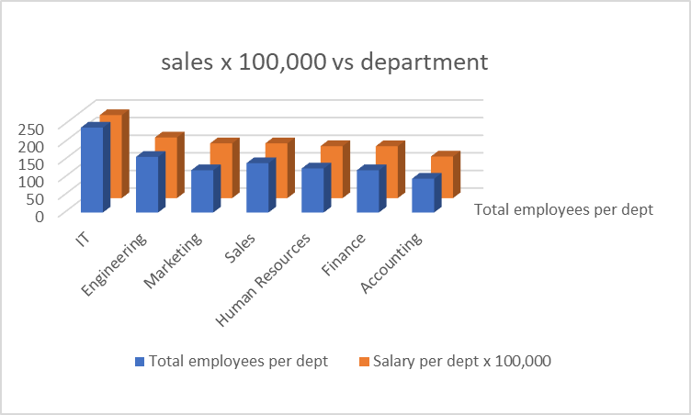
ANAYSIS
In the graph we see the IT department has the highest budget.
And accounting has the lowest salary budget allocation.
The reason for the high salary budget is the high number of employees (241) in the IT department.
The reason for the smallest salary budget in the accounting department is the lowest number of employees (96) in the accounting department

Slide 6
ANALYSIS CONTINUED…
We see from the graph that Seattle has the highest salary budget of all the states.
Rio de Janeiro has the lowest salary budget

Slide 7
ANALYSIS CONTD…
Ethnicity | number of employes
Asian | 404
Black | 74
Caucasian | 271
Latino | 251
Grand Total | 1000

Slide 8
ANALYSIS CONTD…
We can see from the pie chart that the company has slightly more females.

Slide 9
FINDINGS
From the analysis we have found that the company is gender balanced with a 52% female to 48% male ratio
We have found that the Highest salary budget is allocated to the Asian Ethnicity and the lowest is the Black ethnicity. This is because the company hires more Asian employees compare to Black employees.
We have also found a positive correlation between the number of employees and Salary budget per department.

Slide 10
Recommendations
Looking at the current Economic situation, we have come up with some recommendations that can greatly save the company finances.
The company has three Analyst departments which can be at most streamlined to two departments, therefore reducing the salary budget.
Investing in IT automation to reduce the number of IT employees
Employ more people from the Black Ethnicity to have a well balanced ethnicity in the company.

Slide 11
THANK YOU

